Slide 1
Lecture 3: ER Diagram

Slide 2
Designing a Database
Requirement Gathering
Conceptual Design → Conceptual Model
Entity Relationship Diagram (ERD)
Logical Design → Logical Model
Relational Schema
Physical Design → Physical Model
Actual implementation on a DBMS
Indexes
Views
Normalize or de-Normalize
Security
Access rights
Notes:
Physical design is the time when you abbreviate the names that you chose during logical design. For example, you can abbreviate the column name that identifies employees, EMPLOYEE_NUMBER, to EMPNO.

Slide 3
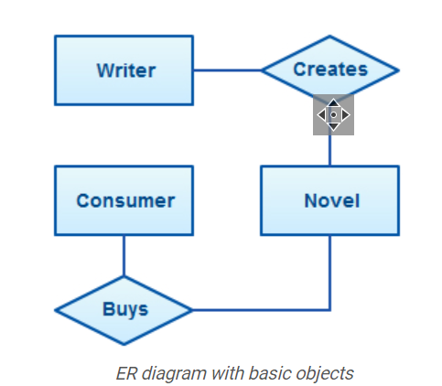
Conceptual design
Pictorial Form / Flow chart
Made for client
Easy to understand
Inexpensive to change

Slide 4
We will start with Conceptual design

Slide 5
ER diagram
An entity relationship diagram (ERD) shows the relationships of entity sets stored in a database.
ER diagrams are used to sketch out the design of a database.

Slide 6
ER Concepts
Entity (Nouns in the text )
Attributes (Properties of the Entity)
Relationship (Verb, relationship between the entities)
Example:
A student ‘Ali’ with id ‘1100’ takes a course of ‘Database Systems’.

Slide 7
Entity representation in ER Diagram (Rectangle)
Student
Course

Slide 8
Strong Entity vs Weak Entity
An entity is strong if it can independently exist
An entity is weak when its existence depends on another entity.

Slide 9
Example of weak entity
Child can't exist without parent
Section can't exist without class
Account can't exist without bank
Representation
Section

Slide 10
Attributes representation in ERD (Oval)
Properties of an entity
id
Student
name

Slide 11
Types of an attribute
Types of attributes
Simple attribute
Composite attribute
Derived attribute
Single-valued attributes
Multivalued attribute
Key attribute

Slide 12
Types of Attributes
Simple Attributes
Simple Attributes are independent attributes that cannot be classified further.
A Student is an entity that consists of attributes Roll No, Age, Class.
Here, we cannot divide the Roll no attribute into sub-attributes.
Composite Attribute
We can divide it into different components.
We divide Composite Attribute into sub-parts that form simple attributes.
If Name is an attribute for Student entity. We can divide the Name attribute into first name, middle name, last name attributes.

Slide 13
Types of Attributes
Single Valued Attributes
The attributes which can store only one value are known as Single Valued Attributes. These attributes cannot store more than one value.
The attributes of an Employee entity are Employee id, DOB, Gender. An employee has only one employee id which is unique, and it also has a single date of birth.
Multi-Valued Attributes
The attributes which can store more than one value.
An Email id and Contact No are the attributes of the Employee entity. An employee can provide more than one email id and contact no.
Multivalued attributes are depicted by double ellipse

Slide 14
Types of Attributes
Derived Attributes
Those attributes that are derived from the value of another attribute.
For example, We can calculate the age from the date of birth value. Therefore, Age attribute can be derived from the DOB attribute.
Derived attributes are depicted by dashed ellipse.
Key Attributes
Every entity has a special attribute that holds a unique value to identify the entity in the entity set. The value of key attributes must be unique and cannot be used again.
Employee id of an employee entity, Roll No of a Student entity.

Slide 15

Attributes
Month
date
DOB
Age
year
CGPA
Hobby
Student
Roll No
Notes:
Age needs to be updated after every year separately for every individual. So we keep it derived.

Slide 16
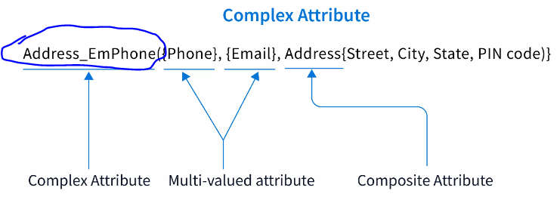
Complex attribute
Nesting multi-valued and composite attributes together form a complex attribute.

Slide 17
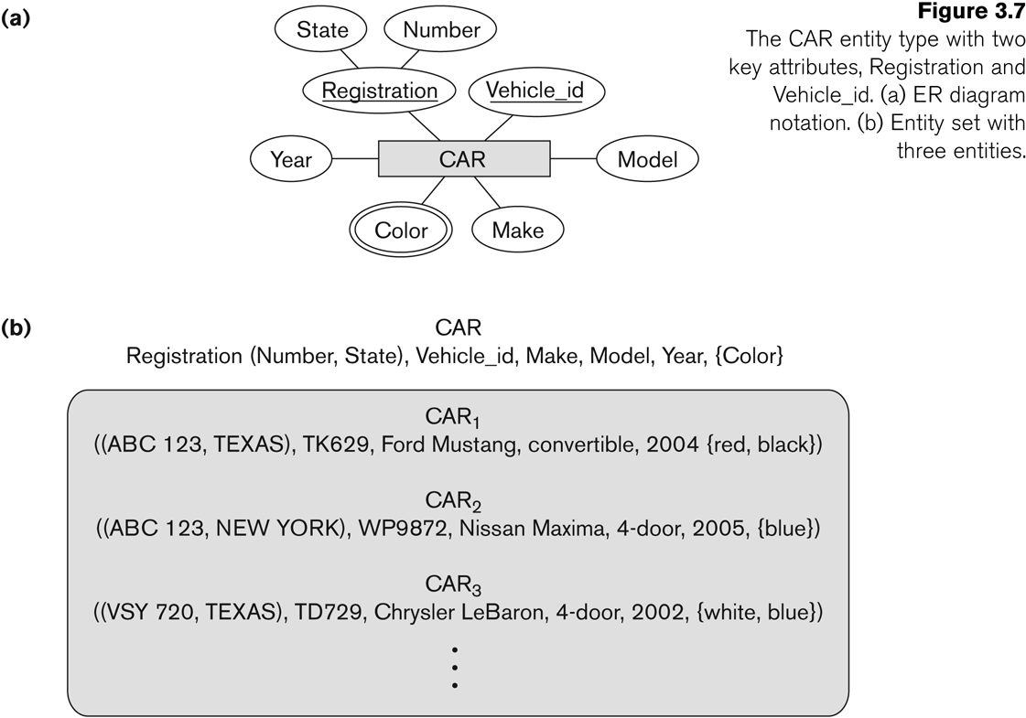
Types of keys

Slide 18
Relationship representation in ERD (Diamond)
Please note: Readability is Left to Right & Top to bottom
Student
Enrolls in
Course
Is taught by
Teacher

Slide 19
Wrong structure
Teacher
Please note: Readability is Left to Right & Top to bottom
Correct it.
Is taught by
Course
Enrolls
Student

Slide 20
Constraints on Relationship
Cardinality
Participation
One to many (1:N)
One to one (1:1)
Many to many (M:N)
Total Participation
Partial participation

Slide 21
Cardinality
Cardinality: represents the number of times an entity of an entity set participates in a relationship set.
One to many (1:N)
When each entity in each entity set can take part only once in the relationship, the cardinality is one to one.
Many to one (N:1)
When entities in one entity set can take part only once in the relationship set and entities in other entity set can take part more than once in the relationship set, cardinality is many to one.
Many to Many (M:N)
When entities in all entity sets can take part more than once in the relationship

Slide 22
Relationship: cardinality
1 : M
M : N
1 : 1
Works for
1
Faculty
M
Department
Teaches
M
Faculty
N
Courses
1
1
Faculty
Is head of
Department

Slide 23
Participation constraint
Total Participation
Each entity in the entity set must participate in the relationship.
If each student must enroll in a course, the participation of student
will be total.
Total participation is shown by double line in ER diagram.
Partial Participation
The entity in the entity set may or may NOT participate in the relationship.
If some courses are not enrolled by any of the student, the participation of course will be partial

Slide 24
Relationship: Particitaion
Total or partial
Faculty
works
Department
Faculty
Teaches
Courses
Faculty
Is head of
Department

Slide 25
Relationship: cardinality and Participation
1 : M
M : N
1 : 1
works
1
Faculty
M
Department
M
N
Faculty
Teaches
Courses
Is head of
1
Faculty
1
Department

Slide 26
Attributes of relationship
A relationship can have attributes:
For example, grade of enrolls
Its value for each relationship instance describes the grade a student takes when he/she is enrolled in a course.
A value of Grade depends on a particular (Student, Course) combination
Students
Enrolls
Course
Grade

Slide 27
Recursive Relationship: Rolenames
Employee is supervisor of other employees
Employee
supervisee
Supervisor
is supervisor of
1
M

Slide 28
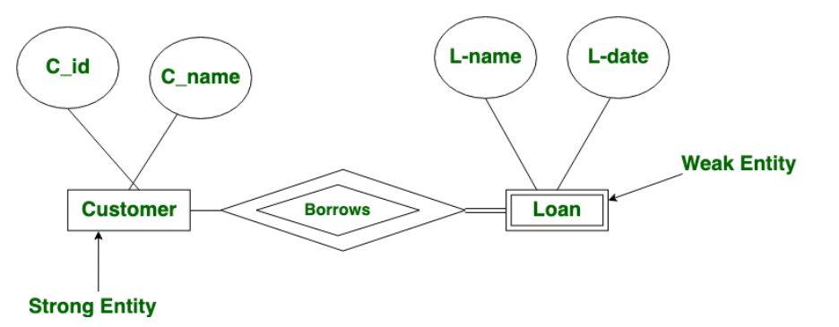
Identifying relationship
Relationship between a strong and weak entity is called identifying.
Strong entity may have total or partial participation while weak entity must have total participation

Slide 29
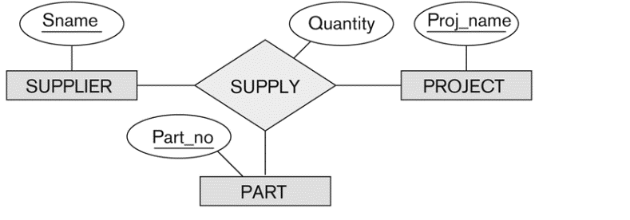
Ternary relationship

Slide 30
Mention cardinality & participation Identify Weak entities Identify relationship attributes
The company is organized into departments. Each department has a unique name, a unique number, and a particular employee who manages the department. We keep track of the start date when that employee began managing the department. A department may have several locations.
A department controls a number of projects, each of which has a unique name, a unique number, and a single location.
We store each employee’s name, Social Security number,2 address, salary, gender , and birth date. An employee is assigned to one department, but may work on several projects, which are not necessarily controlled by the same department. We keep track of the current number of hours per week that an employee works on each project. We also keep track of the direct supervisor of each employee (who is another employee).
We want to keep track of the dependents of each employee for insurance purposes. We keep each dependent’s first name, gender, birth date, and relationship to the employee.

Slide 31
